Slide 1


SMART INDIA HACKATHON 2025
TITLE PAGE
Problem Statement ID – 25109
Problem Statement Title- Student Innovation: Swadeshi for Atmanirbhar Bharth
Theme- Agriculture, FoodTech & Rural Development
PS Category- Hardware
Team ID-
Team Name- Maverick

Slide 2
Plantologica: Smart IoT Soil Health Monitor
Maverick
Problem Solution
ESP32‐based soil sensor measuring moisture, NPK, and pH
Sends readings to a mobile app
Plant selection
Configurable Bluetooth LE / Wi-Fi data transmission
How it Addresses the Problem
Replaces guesswork with live, plant-specific soil data
Rule-based suggestions trigger timely fertilizing and watering
Enables 15–28% yield improvement and ~20% input savings
Empowers new-age farmers with precise, actionable insights
Uniqueness
User-guided recalibration keeps sensor accuracy within ±5%
Designed for small to mid-scale plots for best ROI
Simple rule-based logic for clear, fast recommendations
Portable device for flexible agricultural purposes

Slide 3
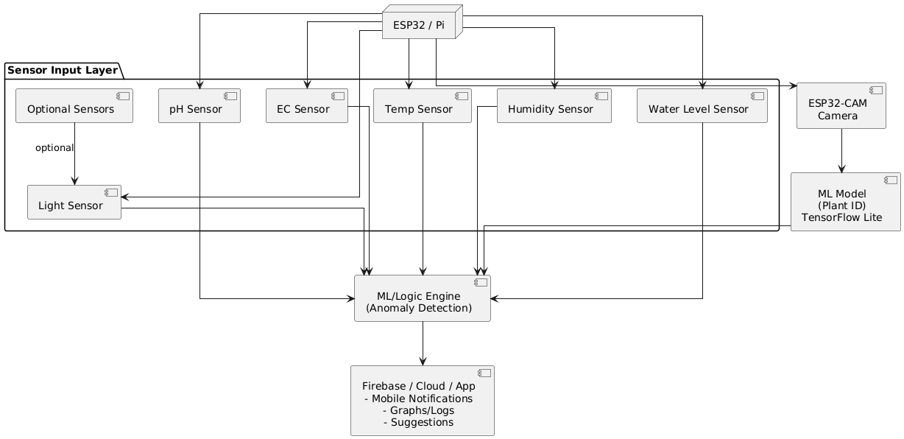
TECHNICAL APPROACH
Maverick
Frontend
Next.js
Backend
LLM
Hardware
ESP32
pH Sensor (PH4502C)
NPK Sensor (JXBS3001NPKRS)
Capacitive Soil Moisture Sensor
EC Sensor
Light Intensity Sensor(BH1750)
Temperature Sensor(TMP36)

Slide 4
FEASIBILITY AND VIABILITY
Maverick
Feasibility Analysis
Uses affordable ESP32 and standard sensors, making hardware production cost-effective
Mobile app matches user tech habits, minimizing training requirements
Improves data reliability with strong network access
Phased approach ensures manageable development and early problem detection
Challenges & Risks
Sensor drift affecting reading accuracy
User adoption hindered by setup complexity
Need for localized recommendations beyond generic rules
Risk Mitigation Strategies
User-friendly recalibration maintains sensor accuracy
Intuitive app design and setup guides to enhance adoption
Customizable rules based on soil and plant types for relevance

Slide 5
IMPACT AND BENEFITS
Maverick
Potential Impact on Target Audience
Enables growers to make data-driven soil health decisions
Reduces crop failures and boosts plant growth confidence
Simplifies technology adoption for non-experts
Supports farmers in optimizing input use for higher productivity
Benefits
Social
Accessible smart farming tools
Enhances food security
Encourages knowledge sharing
Economic
Increases yields 15–28%
Cuts input costs ~20%
Saves labor and time
Environmental
Reduces chemical runoff
Saves water resources
Supports sustainable farming

Slide 6
RESEARCH AND REFERENCES
Maverick
"Soil Nutritional Recommendations for Soil Fertilization Using Machine Learning" – Details a mobile app integrating soil type and crop data with ML-powered nutrient recommendations and weather data for precision fertilization [IJERT 2025].
"IoT Solutions for Smart Farming: Use Cases & Challenges" – Overview of IoT applications in agriculture, focusing on cost savings, yield boosts, and system challenges relevant to your ESP32 IoT solution [WebbyLab 2025].
"A Systematic Review of IoT Solutions for Smart Farming" (2020) – Over 470 citations, comprehensive review of IoT adoption, hardware, protocols, and AI in smart farming [PMC]
"The IoT and AI in Agriculture: The Time Is Now" (2025) – Latest review with focus on AI + IoT integration in precision farming, challenges, and innovations [PMC]

